Slide 1
Results of the week
Daniil Terebilenko
Junior DevOps Engineer

Slide 2



Python
Finally done

Slide 3

Ansible
Roles
Playbooks
Ad-hoc commands

Slide 4
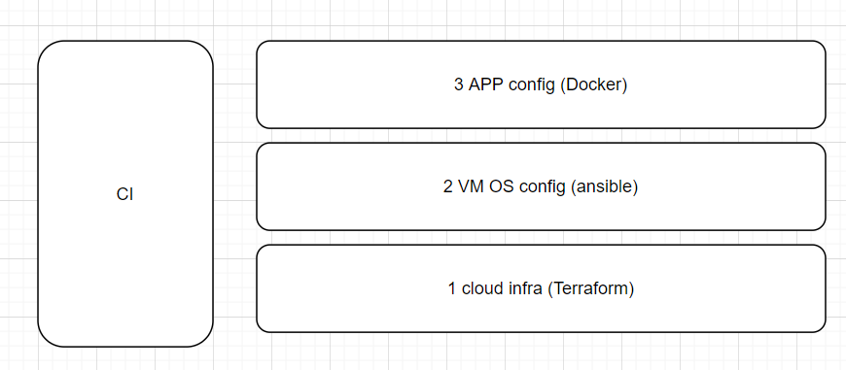
Infrastructure

